Slide 1
Employee Attrition Prediction
Abstract
Employee attrition, the phenomenon of employees voluntarily leaving an organization, presents significant challenges to businesses, including loss of talent, decreased productivity, and increased recruitment costs. Predicting employee attrition can help organizations proactively address retention strategies and mitigate its adverse effects. In this project, we propose a machine learning approach utilizing the Random Forest algorithm for predicting employee attrition. Random Forest, a powerful ensemble learning technique, leverages the collective wisdom of multiple decision trees to make accurate predictions. Our model integrates various employee-related features such as job satisfaction, salary, tenure, performance ratings, and demographic information to predict the likelihood of attrition. Through extensive experimentation and validation on real world employee datasets, we demonstrate the effectiveness of our approach in accurately identifying individuals at risk of attrition. The proposed model not only provides valuable insights into the factors influencing attrition but also empowers organizations to proactively implement targeted retention strategies, thereby fostering a more stable and engaged workforce.

Slide 2
Existing System
Manual Tracking
Reactive Approach
Lack of Predictive Insights
Currently, employee attrition is tracked manually, relying on HR reports and exit interviews.
Existing systems respond to attrition after it occurs, rather than proactively identifying and addressing the underlying issues.
Without data-driven analysis, organizations lack the foresight to anticipate and mitigate employee turnover.

Slide 3
Proposed System
Predictive Analytics
Proactive Retention Strategies
Data-Driven Decisions
Our machine learning model will analyze employee data to predict attrition rates and identify key factors driving turnover.
By anticipating attrition, organizations can implement targeted interventions to improve employee satisfaction and reduce turnover.
The proposed system will provide data-driven insights to help HR teams make informed decisions about workforce management.

Slide 4
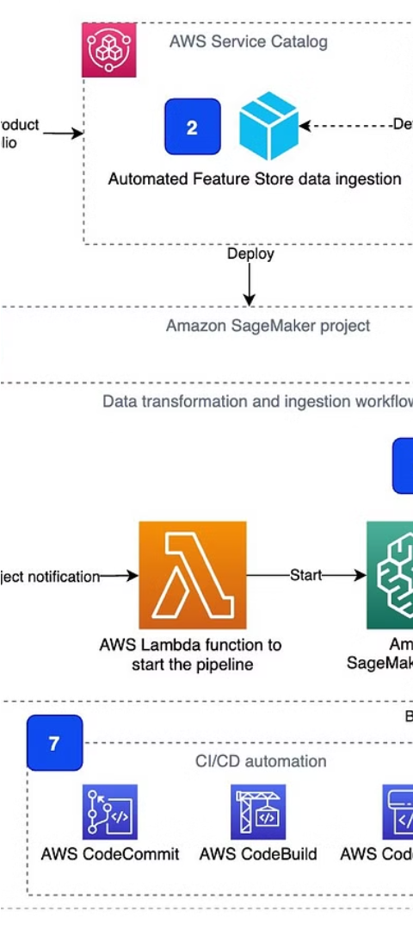
System Architecture
1
Data Collection
Gather employee data from various sources, including HR records, performance reviews, and exit interviews.
2
Data Preprocessing
Clean, normalize, and transform the data to prepare it for machine learning analysis.
3
Model Training
Train the random forest algorithm on the preprocessed data to create the predictive model.

Slide 5
List of Modules
1
Data Extraction
2
Data Preprocessing
Gather and consolidate employee data from various sources.
Clean, normalize, and transform the data for machine learning analysis.
3
Model Training
4
Prediction and Reporting
Train the random forest algorithm to create the predictive model.
Generate attrition predictions and provide insights to HR teams.

Slide 6




Functional Description
Data Collection
Data Preprocessing
Model Training
Prediction and Reporting
Gather relevant employee data from HR systems, performance reviews, and other sources.
Train the random forest algorithm on the preprocessed data to create the predictive model.
Clean, normalize, and transform the data to ensure it's ready for machine learning analysis.
Generate attrition predictions and provide actionable insights to HR teams.

Slide 7




Implementation
Data Gathering
Data Preprocessing
Model Training
Model Deployment
Collect employee data from various sources, including HR records, performance reviews, and exit interviews.
Clean, normalize, and transform the data to prepare it for machine learning analysis.
Train the random forest algorithm on the preprocessed data to create the predictive model.
Integrate the trained model into the organization's HR systems to provide real-time attrition predictions.

Slide 8
Conclusion and References
By implementing our machine learning-based employee attrition prediction system, organizations can proactively identify and address the factors driving employee turnover, leading to improved workforce retention and productivity.
For further information, please refer to the following resources:
Employee Turnover Costs
Reducing Employee Turnover with People Analytics
The High Cost of Low Wages

